Slide 1

City Clerk Ballot Measure 2024
City Council Meeting
November 15, 2023

Slide 2
BACKGROUND
October 18, 2023 - The Mayor recapped a recent discussion with the elected City Clerk, who had indicated he supported the consolidation of the elected City Clerk position into an appointed staff position. The proposed consolidation of the Clerk position was based upon the professional recommendations of City staff and consistent with practice in 16 of 19 Contra Costa agencies.
  The City Council directed staff to place this topic on a future meeting agenda for discussion.
November 1, 2023 - Staff presented to City Council a comparative analysis of Clerk Offices in other California municipalities who recently transitioned their City Clerk to an appointed position. City Council favored the proposal and directed:
  Delegating the appointing authority to City Manager.
  Clarifying the appointed position will be a consolidation of the elected position with the existing full-time staff position, resulting in reclassifying the Assistant City Clerk as City Clerk.
  Providing an organizational model of the Clerk’s office with an appointed City Clerk.
  Appointing Vice Mayor Ross and Councilmember McKillop to an Ad Hoc Subcommittee for drafting the Argument in Favor.

Slide 3
DISCUSSION
Division Summary
Through the Assistant City Clerk, the Office serves as a primary point of contact for the City Council, City Departments, and the public regarding the legislative history and operations of the City.
Elected Office Structure (Current)
Division under and managed by the Department of the City Manager.
Gary Hernandez, City Clerk (Elected) – Elected Official serving in a ceremonial capacity performing limited duties.
Kat Galileo, Assistant City Clerk (FTE)– Full time staff employee who performs all legal duties and responsibilities of the City Clerk, as well as the day-to-day operations of the Office.
Catherine Muiruri, Clerk Aide (PT) – Part time staff employee provides general administrative support to the Assistant City Clerk and customer service to the Martinez community.

Slide 4
DISCUSSION CONT…
Appointed Office Structure Research
CITY | POPULATION | CLASSIFICATION | UNIT/GROUP | CLERK STAFF
Martinez | 37,658 | Elected | Elected | City Clerk
 |  | FTE | MCP - Management | Assistant City Clerk
 |  | PT Temporary | Misc | Administrative Aide
Hercules | 24,640 | Appointed | Executive | City Clerk
 |  | FTE | Teamster | Senior Clerk
El Cerrito | 25,962 | Appointed | Management | City Clerk
 |  | FTE | Misc | Management Assistant I
Benicia* | 26,180 | Elected | Elected | City Clerk
 |  | PTE | BSPA - Supervisor | Deputy City Clerk
San Pablo | 31,773 | Elected | Elected | City Clerk
 |  | Appointed | Confidential | Assistant City Clerk
Pleasant Hill | 34,026 | Appointed | Management | City Clerk
Danville | 44,396 | Appointed | Management | City Clerk
Oakley | 44,995 | FTE | Unrepresented - General Staff | City Clerk/Paralegal
 |  | FTE | Unrepresented - General Staff | Deputy City Clerk
 |  | FTE | Unrepresented - General Staff | Office Assistant
Provide and support advancement in the City’s ability to be responsive, transparent, and increase accessibility for the public, staff and City Council.
  2021 – All processes performed manually (except Agenda creation).
  2023 – NetFile, NextRequest, Boards & Commissions, Digital Kiosk
  Future – Claims, Records Management (Laserfiche)
Organizational structure and staffing data collected of other Clerk Offices
  Martinez is in the minority in the County (3/19 cities) and in the State (100/482 cities).

Slide 5
DISCUSSION CONT…
Appointed Office Structure (Proposed)
City Clerk Transition
  Full-time staff position
  Consolidation with Assistant City Clerk
  Job classification to be reviewed, approved, adopted, and incorporated
  Assistant City Clerk Kat Galileo to be appointed as the new City Clerk
    Elected City Clerk’s limited duties transferred
    Continue day-to-day operations and management of the Office
  Clerical Aide duties will remain unchanged

Slide 6
BEFORE AND AFTER
CURRENT OFFICE STRUCTURE
NEW OFFICE STRUCTURE

Slide 7
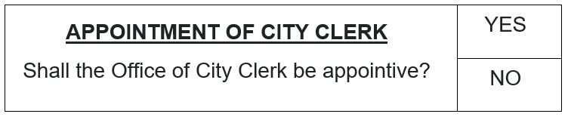
BALLOT MEASURE
Key Components
Voter Approved Measure
Submit to voters for a question regarding whether the City Clerk should be appointive
Calls, gives notice of, and requests consolidation of a Special Municipal Election with the March 5, 2024 Statewide Primary Election
Impartial Analysis and Argument in Favor
Elected City Clerk will serve until November 2024; position eliminated thereafter.
Creates appointive City Clerk staff position (full authority); City Manager becomes the Appointing Authority , through delegation by City Council (GC Section 36510). Municipal Code updated.
November 2024 ballot will not include the race for the City Clerk’s Office.

Slide 8
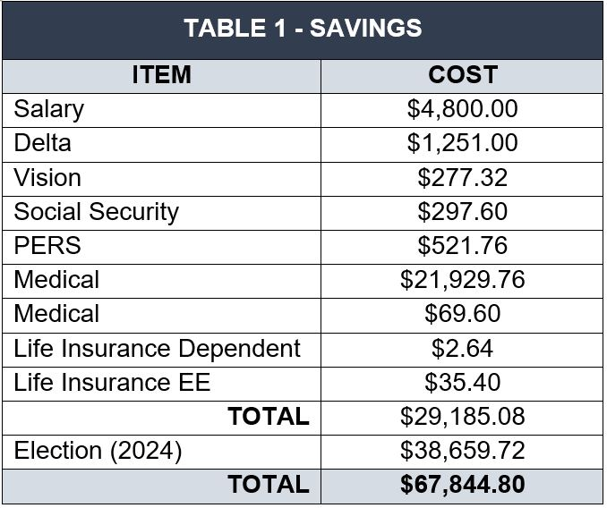
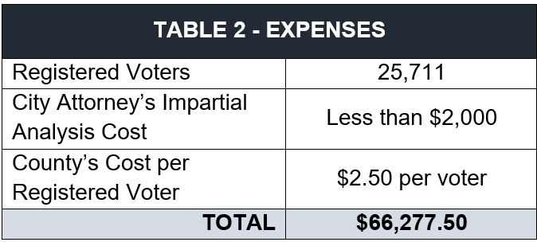
FISCAL IMPACT
Savings
Savings will be reinvested into the Office to cover anticipated expenses and support the Office as it is restructured.
  Salary and benefits of the elected City Clerk
  Election cost for elected City Clerk position (every 4 years)
Expenses
2024 Ballot Measure cost
  Funded in FY 2024 mid-year budget adjustment
Position upgrade from Assistant City Clerk to City Clerk

Slide 9
RECOMMENDATION
Next Steps
Timeline
City Council approve the proposed ballot measure and adopt the resolution.
Upon adoption of the resolution, staff will:
File records with County Elections Office
Publish Notice of Election in the local Newspaper
City Attorney will prepare an Impartial Analysis
December 6 (E-90)
  Adoption of Argument in Favor
December 8 (E-88)
  Deadline to submit measure
December 11 (E-85)
  Measure letter assigned
December 20 (E-76)
  Deadline for Primary Arguments For/Against
December 25* (E-71)
  Deadline for Rebuttal Arguments

Slide 10
THANK YOU
Do you have any questions?

