Slide 1
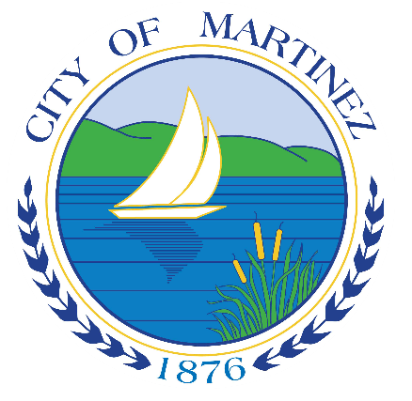
Community Services Overlay District
Informational Presentation
November 1, 2023

Slide 2
Overview
Purpose of CSO District
Background
Description of CSO Provisions and Uses
Next Steps
Questions?

Slide 3
Purpose of the CSO District
Encourage multi-family residential development, particularly affordable housing, on lands owned by existing legal religious organizations and community-oriented non-profit organizations.

Slide 4
Background
Draft 2023-2031 Housing Element Update (HEU) – adopted and submitted to State
State law requires the City to adopt new programs to expand opportunities and encourage new housing
Community Services Overlay (CSO) District is one of several programs to implement the HEU
CSO must be adopted by January 31, 2024

Slide 5
CSO District – Where does it apply?
The CSO District is an overlay zone that applies to sites within the City limits owned by:
Existing, Legal Religious Institutions; and
2. Community-Oriented Non-Profit Organizations
Sites must be owned as of January 1, 2024.

Slide 6
Description of CSO Provisions and Uses
Density: 21 – 50 housing units per acre
Review Process: “By right” stream-lined development processing
Objective Standards: Development standards consistent with the R-1.5 zoning district and applicable Specific Plan
Parking: 1 parking stall per unit plus truck loading requirements

Slide 7
Affordability Terms
Affordability:
20 percent very low-income or low-income units, or
30 percent moderate income units
Deed Restriction:
55 years for rental units
45 years for owner-occupied units

Slide 8
Senate Bill No. 4
“Affordable Housing on Faith and Higher Education Lands Act of 2023” (Gov. Code Section 65913.16)
CSO District is similar to SB 4 - both provide new housing opportunities for religious institution sites
CSO District also allows housing on sites owned by “non-profit community-oriented organizations”
The CSO District is less restrictive than SB 4 by:
level of housing affordability,
prevailing wage/PLA requirements

Slide 9
“By Right” Streamlined Processing
“By Right” Streamlined Processing Benefits:
No discretionary City review process
No CEQA review (California Environmental Quality Act)
Development Project qualifies if it complies with:
Affordability Standards
Density Standards
Objective Development Standards (R-1.5 zoning standards, etc.)

Slide 10
Next Steps
Planning Commission Public Hearing – November 14, 2023, 7:00 p.m.
Planning Commission will make a recommendation to City Council on adoption of all Housing Element Update changes and implementation programs, including adoption of the CSO District. Public Comments welcome.
City Council Public Hearing – December 6, 2023, 7:00 pm
City Council will make a determination on adoption of all Housing Element Update changes and implementation programs, including adoption of the CSO District. Public Comments welcome.

Slide 11
Questions
We are happy to answer your questions now, or you can contact us at:
Victoria Walker, Consultant: vwalker@solutions-mrg.com
Michael P. Cass, Planning Manager: mcass@cityofmartinez.org

