Slide 1
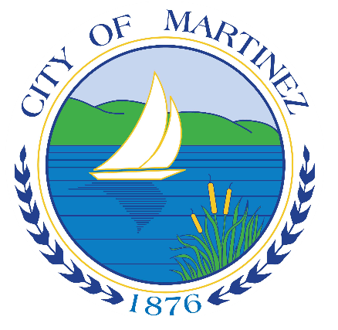
City of Martinez Waterfront and Marina Subcommittee
April 24, 2023

Slide 2
Fishing Pier Update
In December 2022, the City of Martinez was Awarded a $2,5647,600 Economic Development Initiative - Community Project Funding (CPF) grant
CPF grants are selected through a congressionally-directed application process. HUD does not facilitate the grant application process.
CPF grants provide investment in a wide variety of projects such as housing, homelessness prevention, workforce training, public facilities, parks, resilience planning and other critical infrastructure and services.

Slide 3
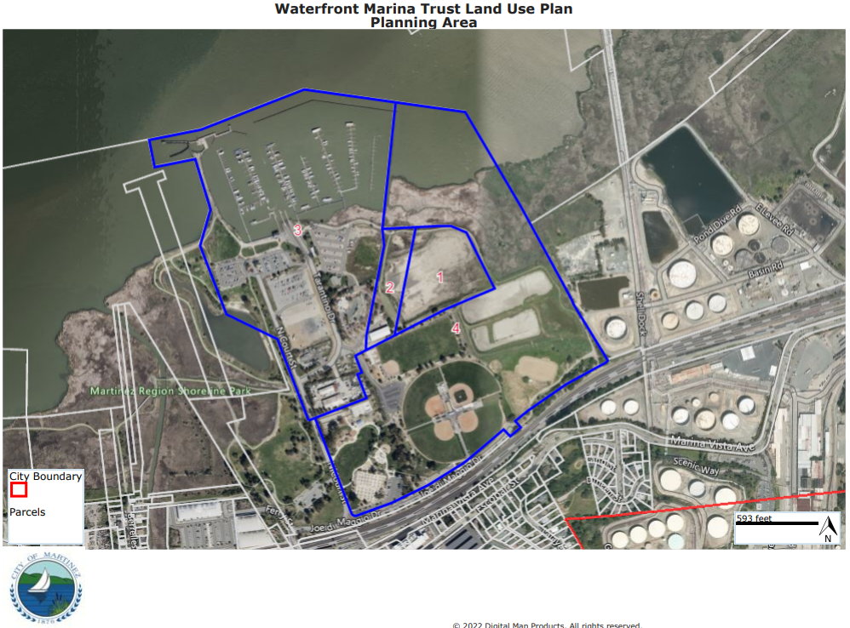
Fishing Pier Update
Fishing Pier restoration inherently connected to overall success of the waterfront and the Waterfront Marina Trust Land Use Plan

Slide 4
Fishing Pier Update
Federal HUD, CPF grants require an environmental assessment by definition, prior to ANY physical work being conducted. Staff recommends the Subcommittee refer to Council a recommendation to authorize and release $150,000 of American Rescue Plan Act (ARPA) funding to jumpstart this project for:
Conduct of an environmental assessment that will satisfy HUD’s requirement to proceed into the next phases of the grant funded work; and,
Professional permitting assistance. Projects “in the Bay” are inherently and notoriously complex to permit – and so expertise in this arena is invaluable to both speed the project along and ensure its timely success.

Slide 5
Fishing Pier Update
Permitting Agencies and Partners

Slide 6
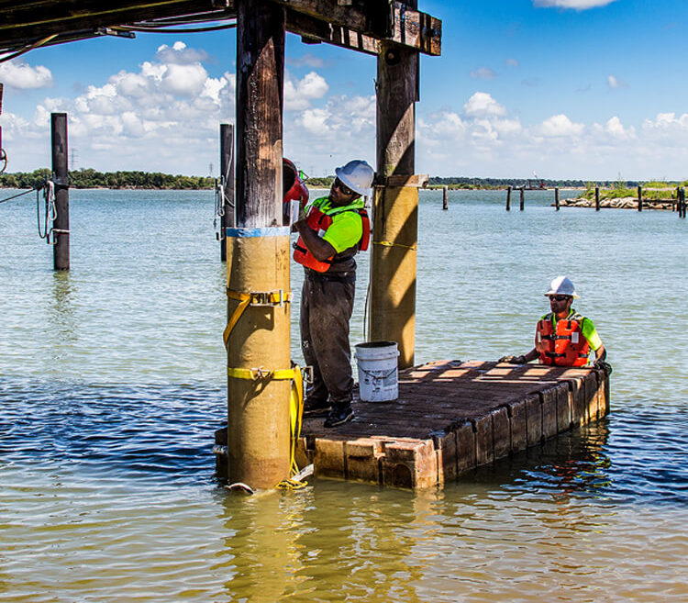
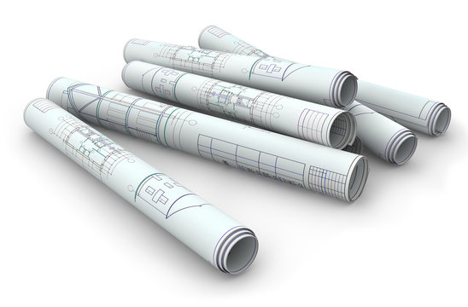
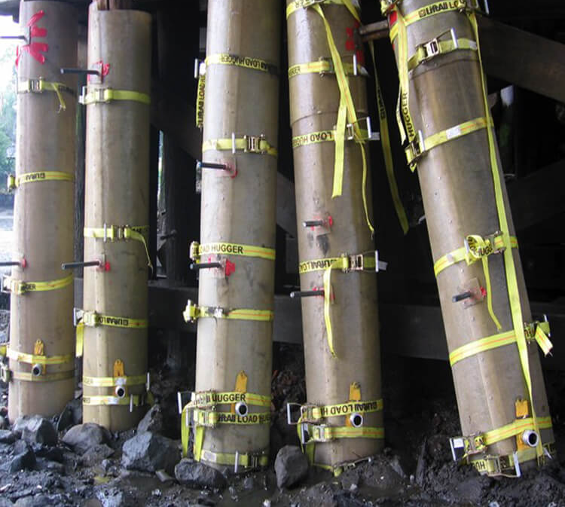
Fishing Pier Update
Inspection and Design

Slide 7
Fishing Pier Update
Questions?

