Slide 1
Martinez Chamber of Commerce & Visit Martinez

Slide 2
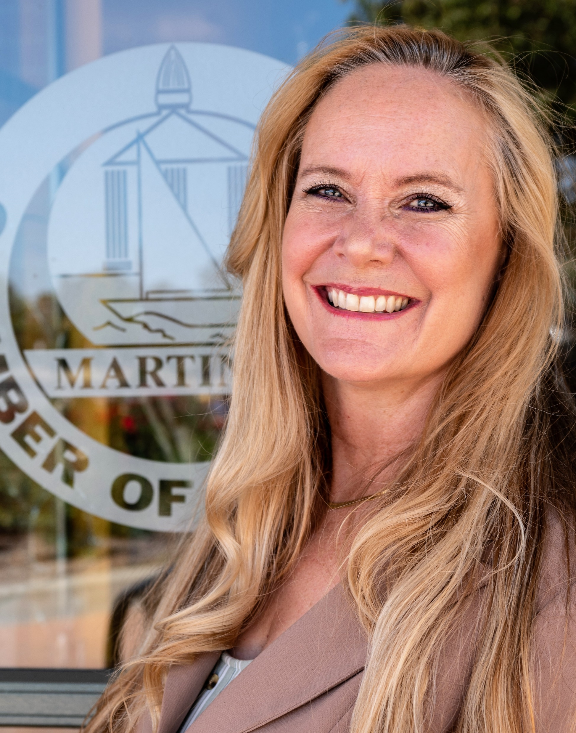
Lisa Bonnington, President & CEO July 2022

Slide 3
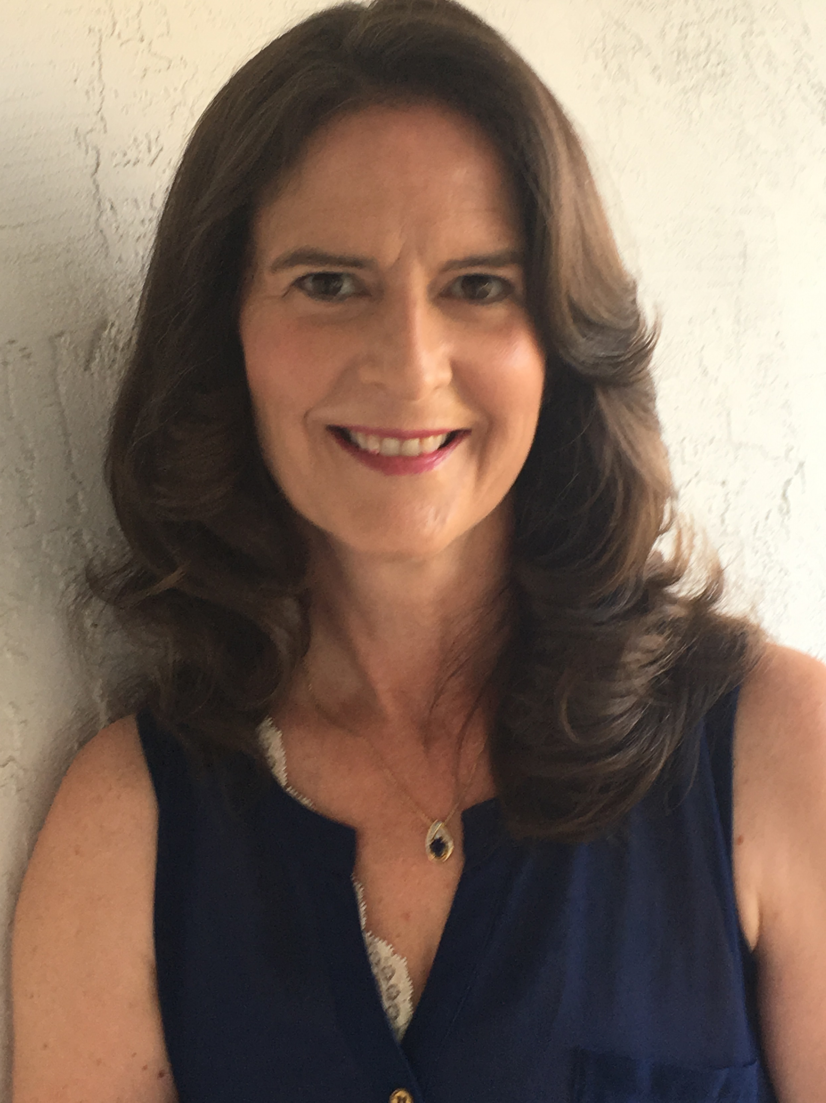
Membership Director
9/2022

Slide 4
The Chamber Purpose, Mission and Vision
The Mission of the Chamber of Commerce is to be a CATALYST for business growth and development, a CONVENER of business leaders and influencers and a CHAMPION for a strong community.
Our Vision is to be a superior Chamber of Commerce providing our members with the best possible opportunities for stability and growth, enticing new businesses, promoting tourism and the arts and creating a quality environment for our community that will lead to strong economic development.

Slide 5
CATALYST Working Hard for You More than ever, our community must work together to build a strong and vibrant place that we call home. The goal of the Martinez Chamber is to be a CATALYST for change that ignites business growth and inspires possibilities, connecting people who collaborate to make smart decisions and move us forward

Slide 6
CONVENERS Making Connections When we come together, we can do great things. In our role as CONVENERS, we connect Chamber members and others in the community to discuss issues, solve problems, build relationships and celebrate successes. We create opportunities for people to meet and learn about what’s possible

Slide 7
CHAMPION for a Stronger Community Every day, we focus on making our community stronger and boosting, quality of life. We promote our members business, encourage shopping locally, and connect B2B services. We push for smart planning. Form strategic partnerships, tackle challenges from workforce training, unhoused issues, public safety and more.

Slide 8
COLLABORATION Creating Space for People to Connect We thrive on collaboration. When people gather in official policy meetings or city council, network in informal settings to discuss issues that impact them, good things happen. That is why we bring members together with community leaders and each other to build relationships, seize opportunities, identify challenges and promote positive outcomes. We are advocates for community action driven by understanding.

Slide 9
2022 STRATEGIC GOALS Increase visibility and influence of the Chamber Create an environment where Martinez businesses can be heard and thrive Create partnerships to leverage services & offerings Successfully upscale existing events Re-establish membership Re-introduce standard programs and services to members and prospects

Slide 10
PARTNERSHIPS Workforce Development Board of CCC East Bay Leadership Council – May Event East Bay Economic Development Alliance SCORE - Satellite Office SBDC 5 C’s – Consideration as Host for MIXPO, Leadership Contra Costa Martinez Adult Education

Slide 11
DIABLO GAZETTE – PROMOTIONAL PARTNERSHIP Helped established a multi-page section dedicated to featuring the CITY OF MARTINEZ. Contribute content, feature ideas, recommendations, calendar of events, ribbon cutting & mixer photos and more Assist in the distribution of the paper at the Chamber Office and through the Ambassador Program

Slide 12
EVENTS

Slide 13
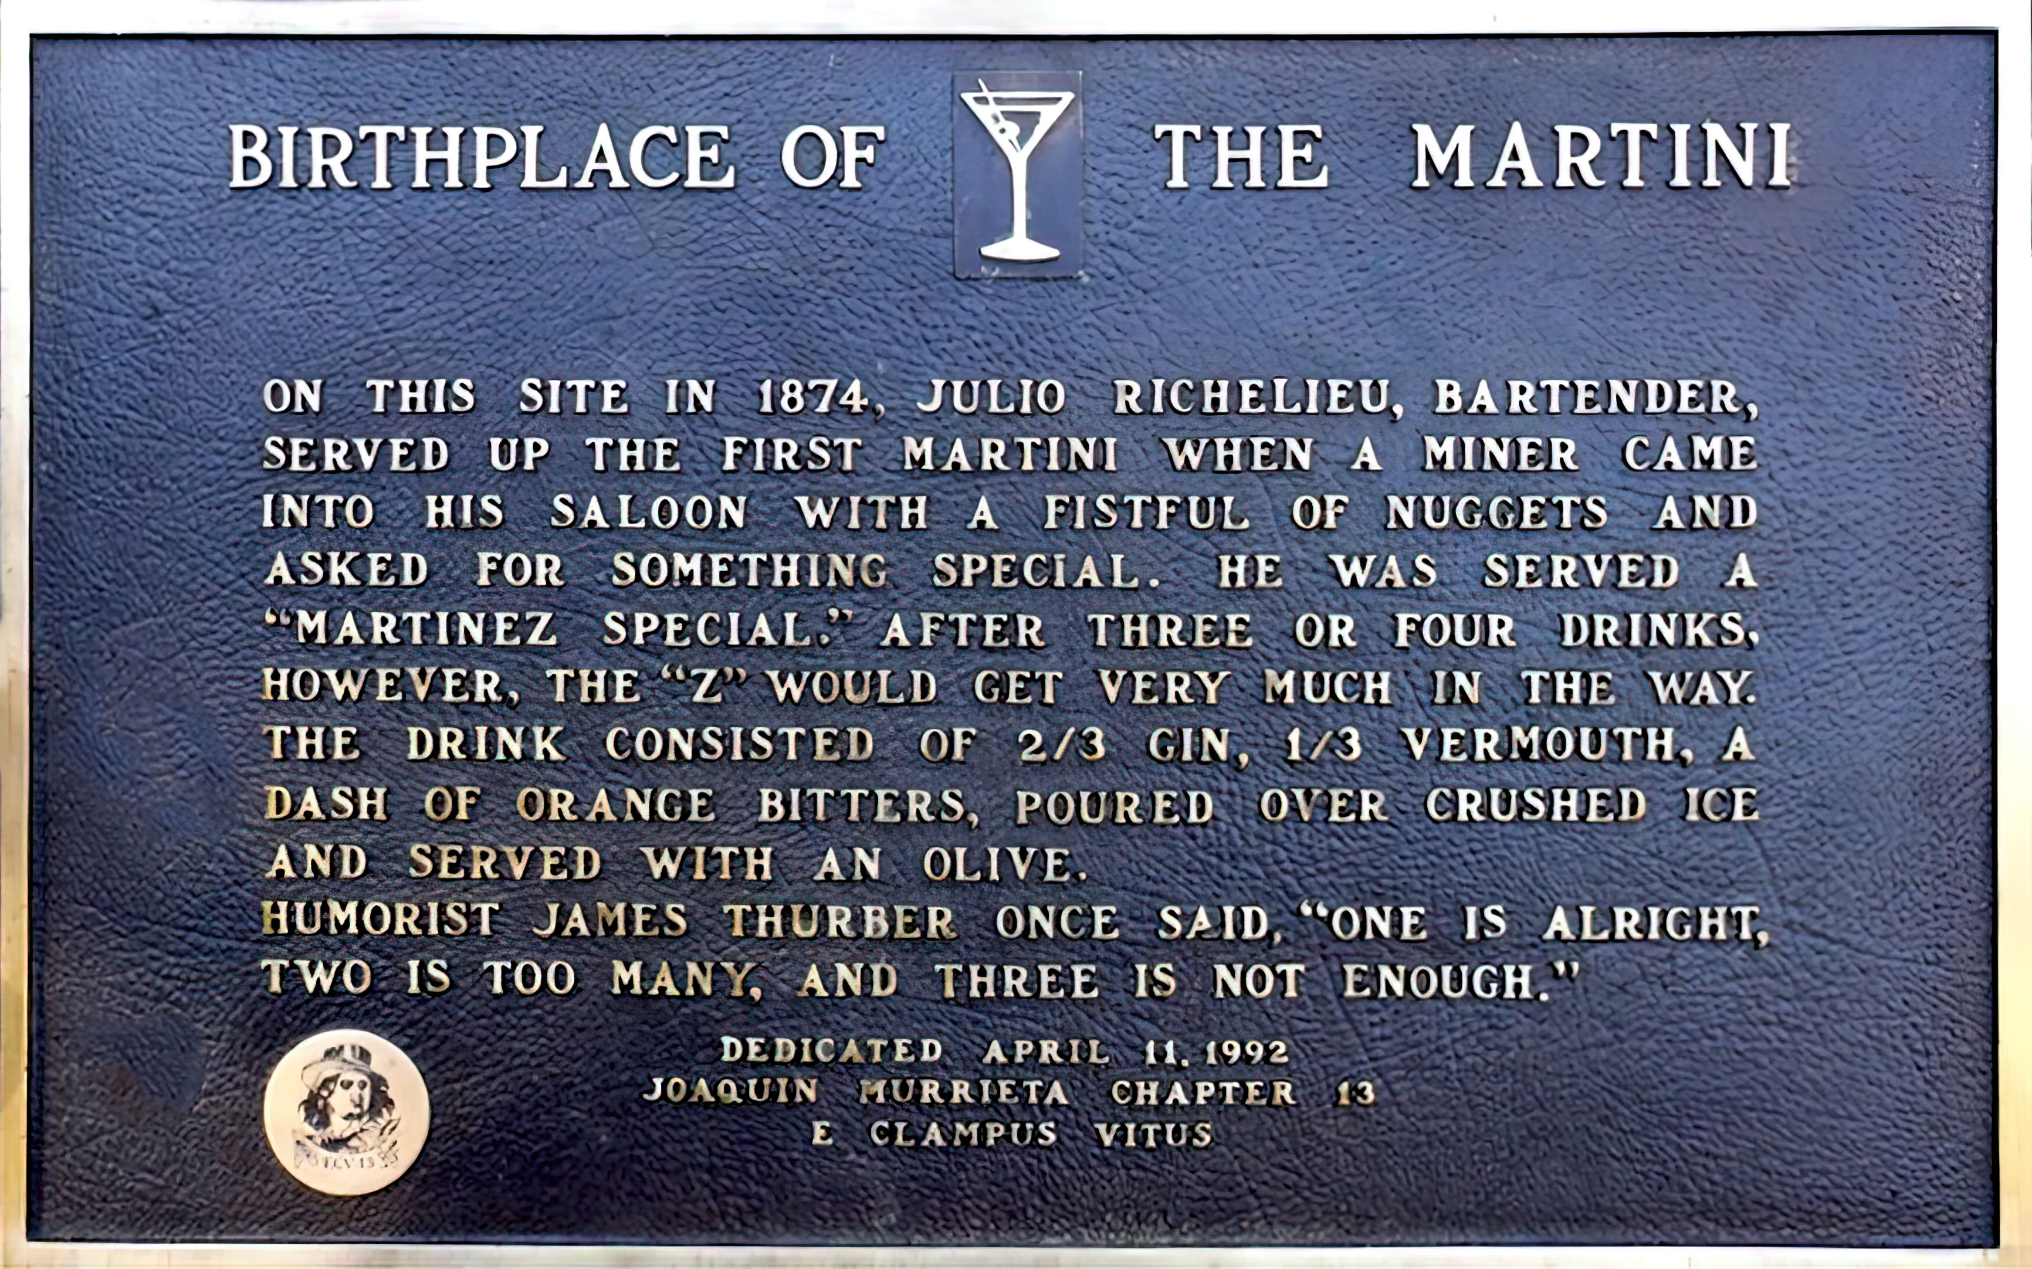
Martini Shake-Off – September 16, 2023

Slide 14
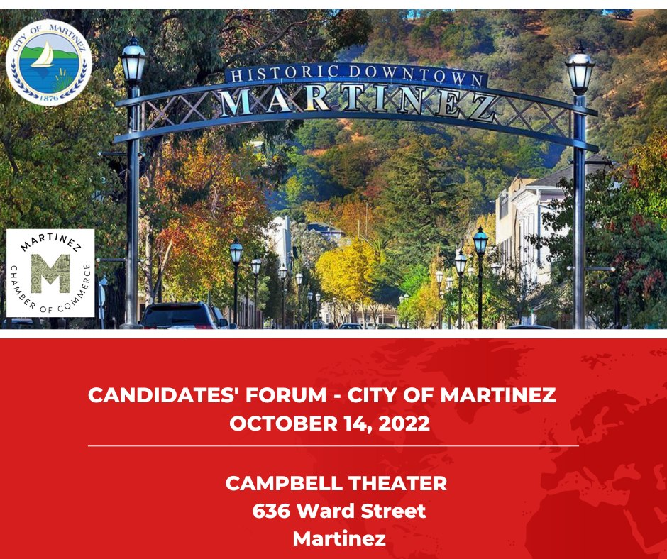
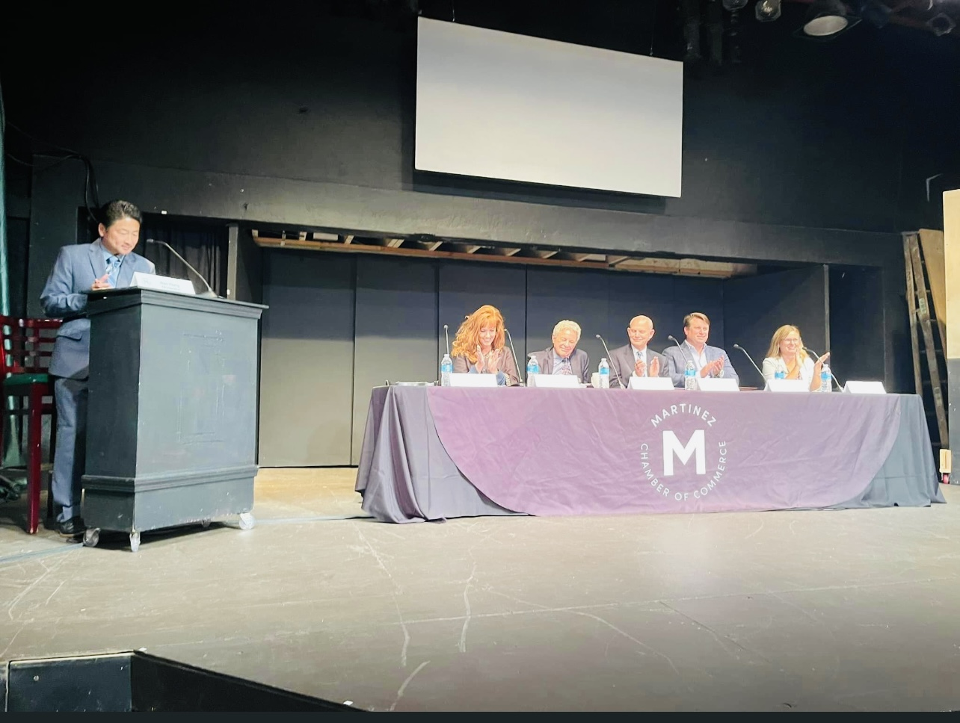
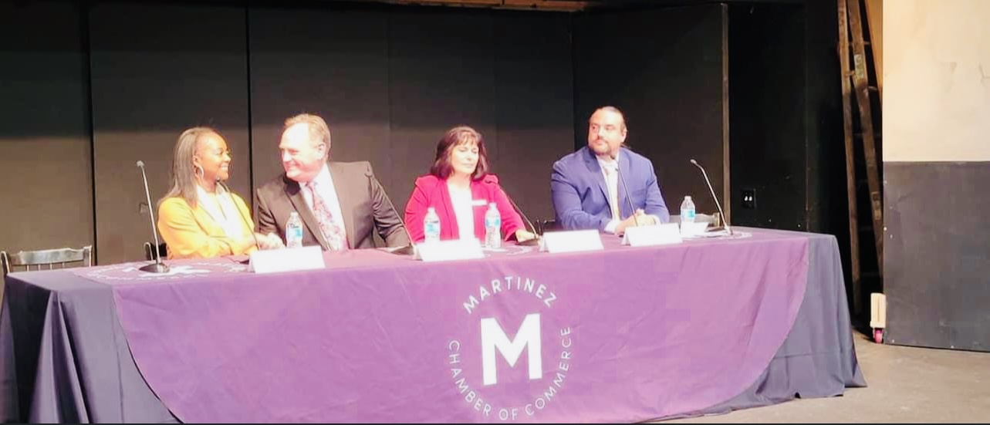
CANDIDATES’ FORUM

Slide 15
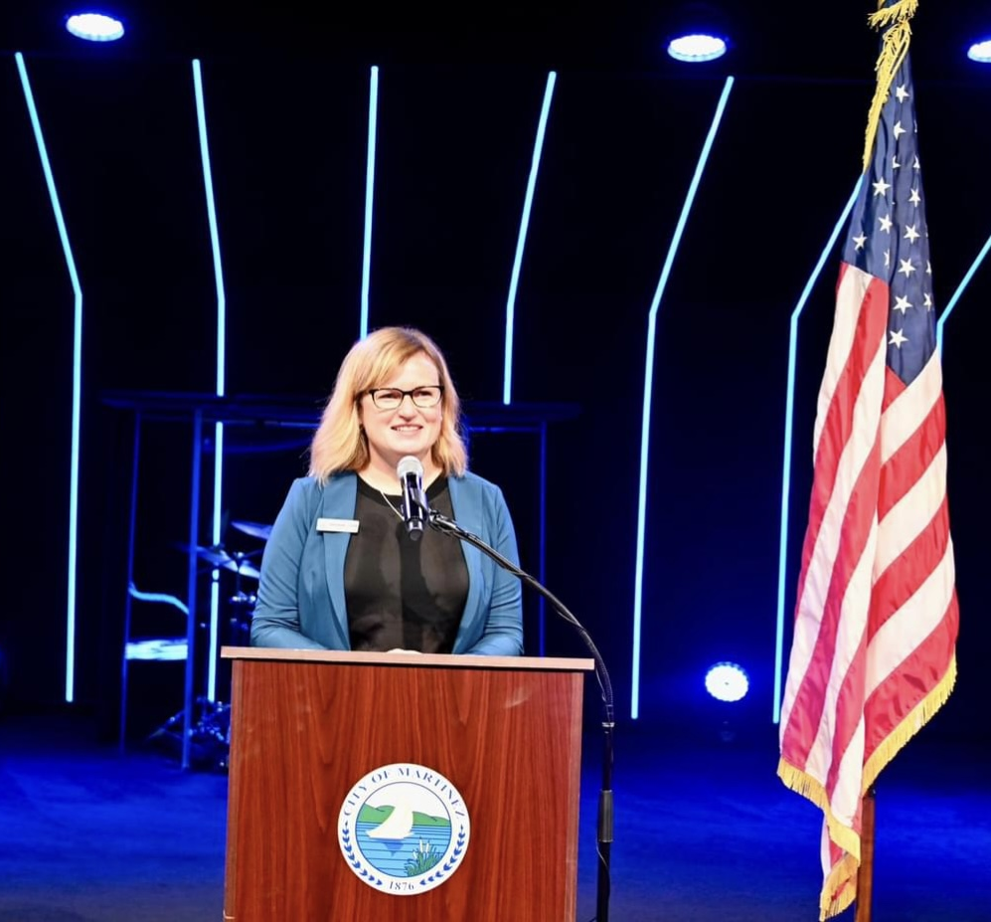
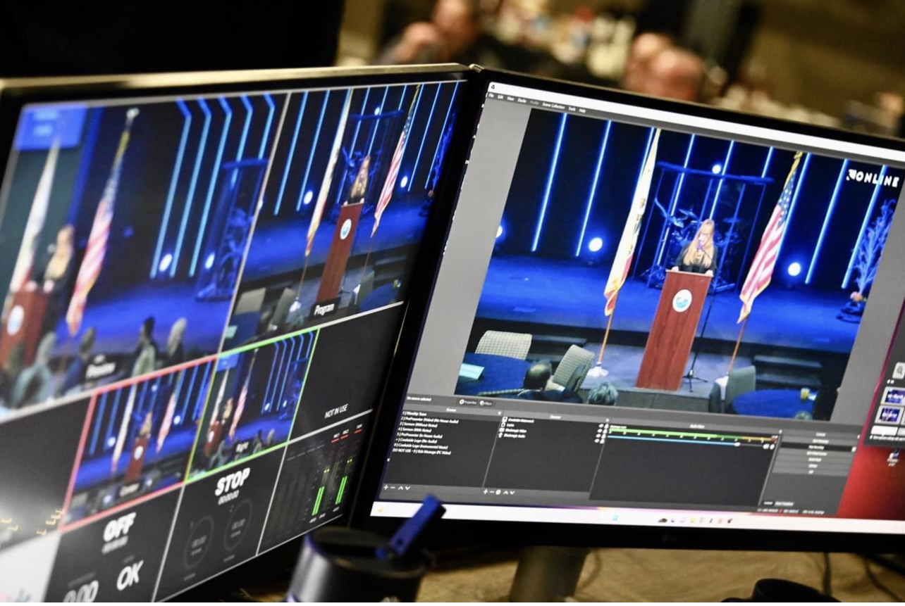

Slide 16
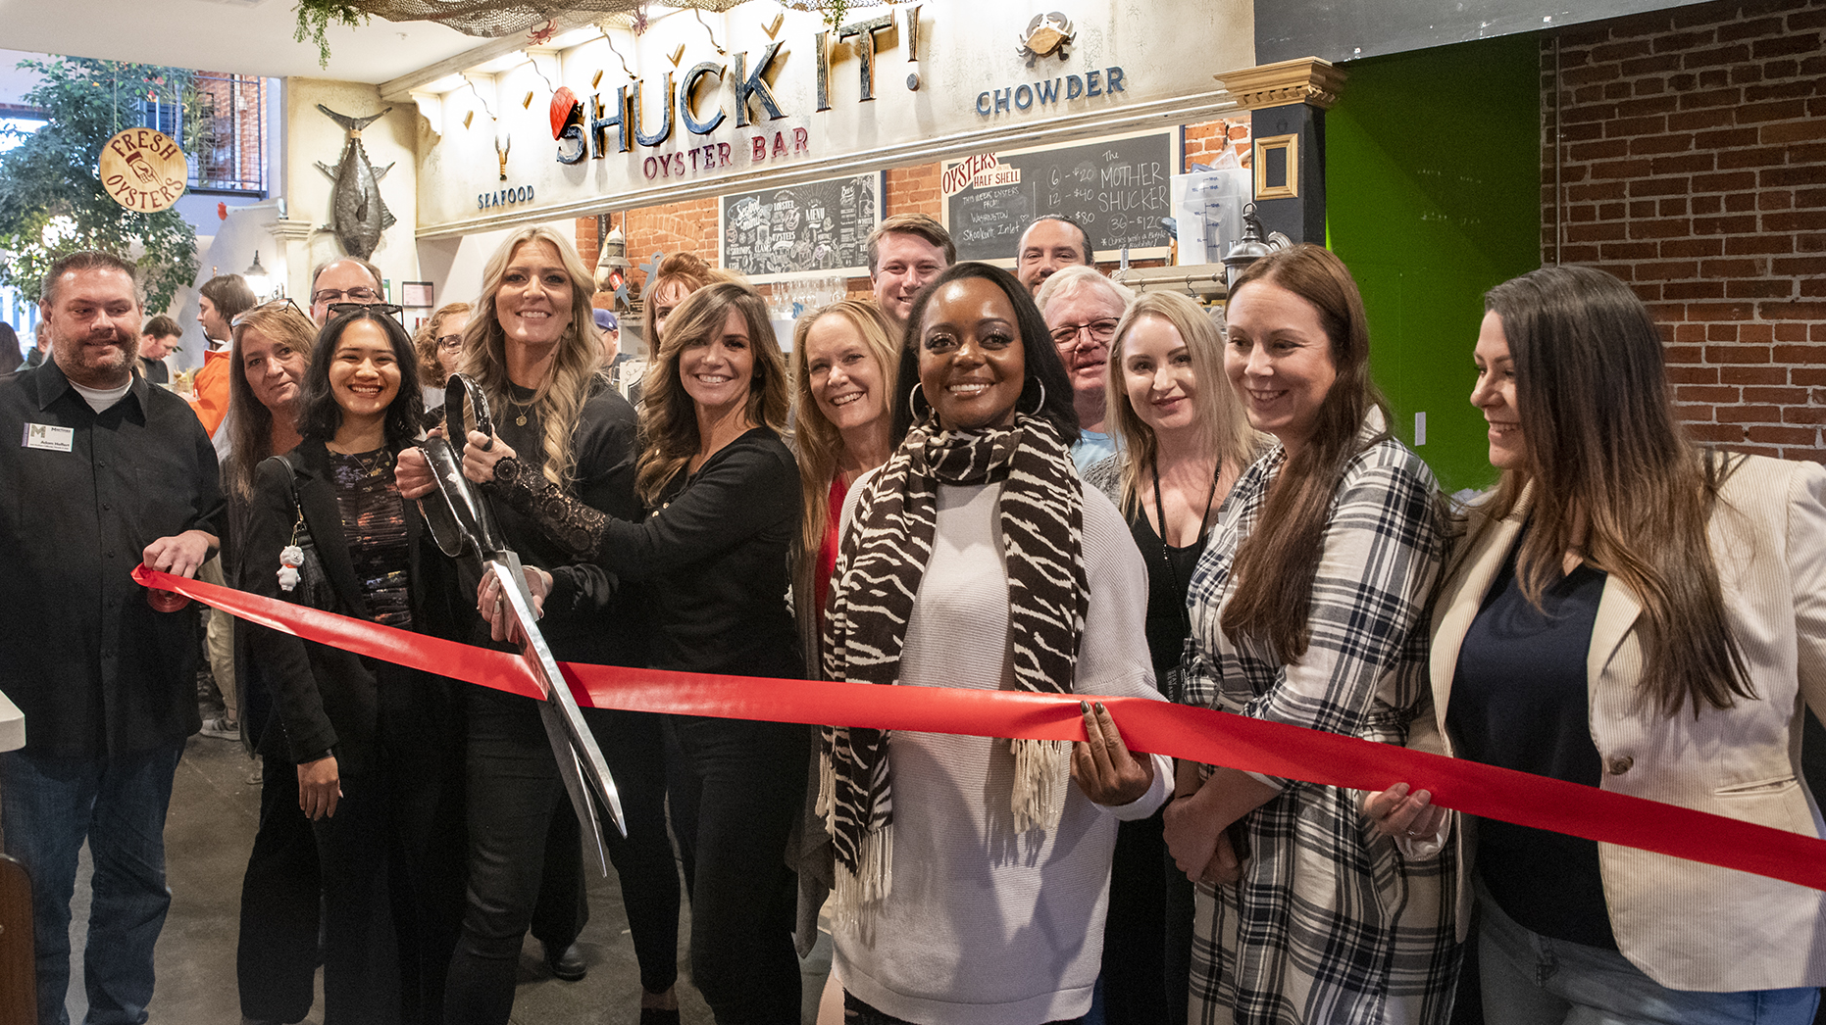
RIBBON CUTTINGS

Slide 17
RIBBON CUTTINGS Shuck It – 11/3 JP’s – 2/9 Alhambra Deli & Donut – 2/23 William Welch Wines – 4/13 Burn Fitness – 4/26 Julian Restaurant – 5/10 Traverso Tree Service – 5/18 The Martinez Sturgeons – 5/26 Inside Out Day Spa – 7/13 Florence Restaurant – 11/9

Slide 18
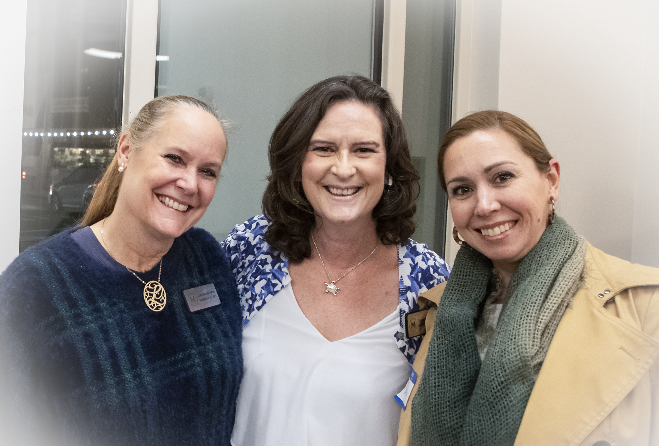
BUSINESS AFTER HOURS NETWORKING MIXERS

Slide 19
NETWORKING MIXERS Market & Main – 12/1 Good to the Bone – 3/2 Breaking Ground Real Estate – 4/23 Martinez Yacht Club – 5/4 Carlton Senior Living – 6/1 Allied Mortgage Group – 10/26

Slide 20
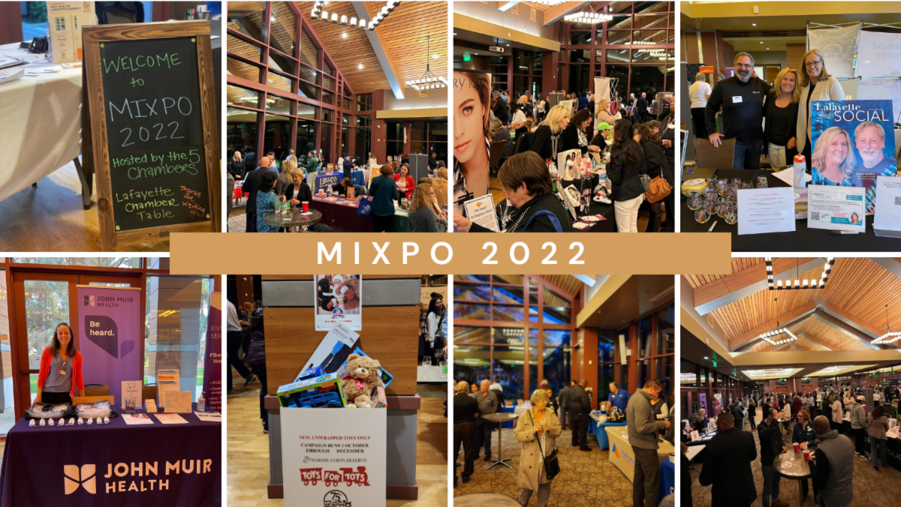
MIXPO

Slide 22
CITIZEN OF THE YEAR & BUSINESS OF THE YEAR Each year the chamber teams up with our community service clubs to honor extraordinary people in our community. These individuals are recognized for their remarkable volunteerism, efforts, achievements and contributions to the community. AWARDS GALA Lifetime Achievement Year Woman & Man of the Year Young Woman & Man of the Year Service without Borders Educator/Teacher of the Year

Slide 23
Endorsed Events & Other Events
EAST BAY LEADERSHIP COUNCIL – 5/24
BOCCE BUSINESS INVITATIONAL – 7/22
NATIONAL NIGHT OUT – 8/1
CENTER WIDE CELEBRATION Virginia Hills Shopping Center – 10/12

Slide 24
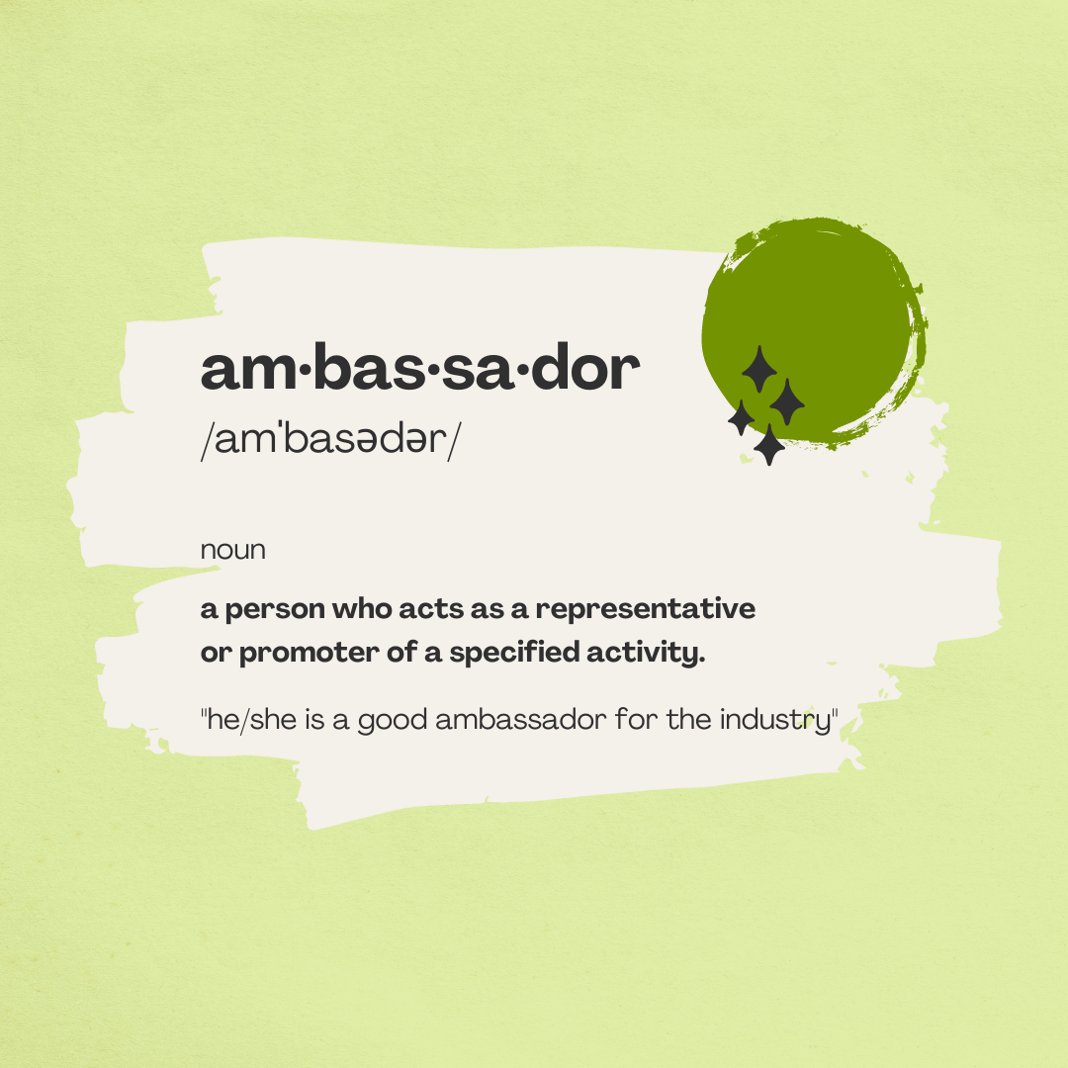
COMMITTEES
Ambassadors
Events
Networking Referral Group
Participate on Sub-Committees
Economic Development

Slide 25
When business owners were asked; "What is the biggest, most important way the Chamber can support your business, how can we help?"
"I believe that the most important way to support my business is for The Chamber of Commerce to share our successes, to post and engage on social media platforms, to Market and Create stories to share, Share our Ads, our specials, what we have to offer.“
JB – Owner of Guava, Vic’s and the Hideout

Slide 26
" When I'm a chamber member, I think it would be amazing if there were more signage, more visibility, more awareness of my business. Whether it's through the Chambers website, Social Media, Street Map of somesort in the plaza, or even have fun and creative ways for us to all participate in something and announced through Ads or email campaigns would be great.“
Larry Woods – Owner & Operator of WCS Construction

Slide 27
Krystal Endsley - Owner of Market & Main and Shuck It Oyster Bar "Marketing is by far the best way. We live in a world where 82% of people in the US use their phones for just about everything; not to mention; guides to new places, new restaurants and shops. Social Media and other Physical Ads or Signage brings people through the doors.“

Slide 28
"Networking events held in my restaurant and Sharing things about our restaurant on Social Media Platforms is key“ – Jesus – Owner of Tzunun

Slide 29
NEW INITIATIVES 2023-2024
STRATEGIC GOALS
IMPLEMENT PROGRAMS AND SERVICES TO HELP RETAIN EXISTING BUSINESSES
HELP ESTABLISH A BRAND AND IDENTITY TO ATTRACT NEW BUSINESSES & CREATE VISIBILITY
ESTABLISH MARTINEZ AS A DESTINATION

Slide 30
The Importance of Social Media Presence
It’s not just about fresh leads, but keeping revenue up across every front. The use of social media marketing will be critical for engaging existing customers, reaching new audiences, building trust and loyalty (that carries into renewals, upsell and cross-sell growth, etc), and much more. Why? Because – today more than ever – buyers listen to real people, not brands. They trust the real- world experiences of their peers
The reason why social media marketing is important now more than ever is because social media is where buyers and customers are engaging. Basically, people are reaching out to one another for guidance, advice, information, resources, and much more. Those people who provide all that begin standing out as thought leaders and subject matter experts. Their perspectives sway decisions.
Build Brand Awareness
Generate Leads - Create meaningful conversations and engagement within their target industry by posting videos, news, data, and interesting trends. Not only do you build credibility with potential customers, but these strategies can result in gaining leads.
Implement Social Listening - Listen to customers and what people are saying about their company. This gives you a chance to get candid feedback about how others view your brand. It opens a window into improving the weaker areas of your business while reinforcing aspects that already resonate with people.
Build a Community With planning and engagement, you can build an active community around your brand on social. You can leverage employees and customers alike to generate immediate Likes and Shares for your content so that it reaches new audiences.

Slide 31
BRANDING & VISIBILITY

Slide 32
MARTINEZ SWAG STORE

Slide 33
BUSINESS OF THE MONTH – Partnership with the City of Martinez

Slide 34
Educational Webinars Workshops Lunch & Learns

Slide 35
BEST OF MARTINEZ

Slide 36
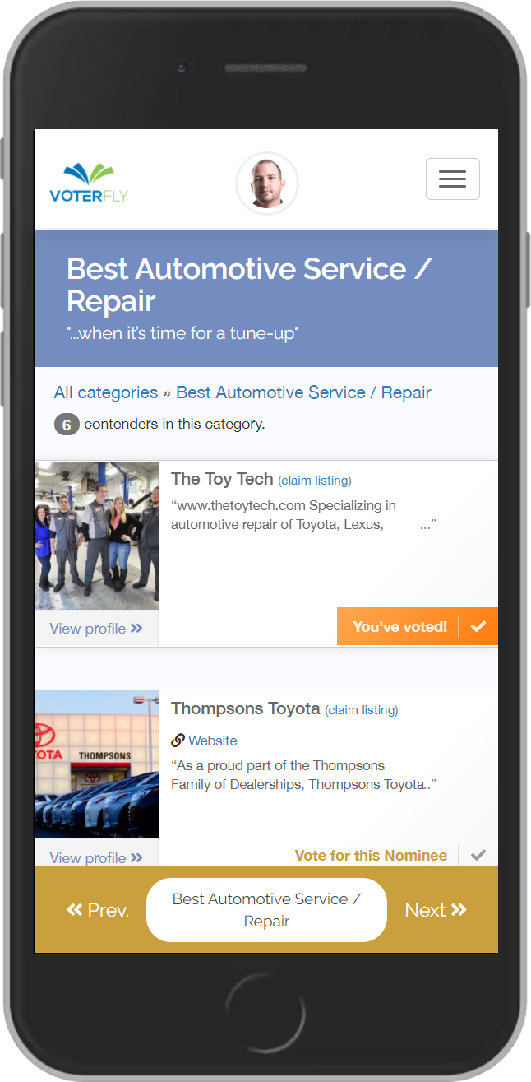
WHAT IS A “BEST OF”?
An online poll that encourages and empowers community members to vote for the businesses, events, individuals, etc. that they feel are “The Best” in any number of customizable categories
WHY RUN A “BEST OF”?
Community Engagement
Recognition
Ability to capitalize on publicity & promotional opportunities
Expand on the “Best Of” awards event as a Citywide Recognition

Slide 37
MARTINEZ MARKETPLACE – Doing something BIG for Small Businesses!
As we move further into the future that’s driven by technology, it’s becoming increasingly clear that online shopping has become a preferred option for many customers.
Being online is important particularly for small businesses. It gives customers another way to buy from small businesses outside of limited store hours and still shop local.
Why a local online marketplace?
Allows business to aggregate together to build a larger network of localized businesses all selling online together
Martinez Marketplace is an ideal way to capitalize on the expansion of 4Martinez.org and create a space for small businesses and entrepreneurs to gain access to low or no cost marketing platform
Is a way to integrate “shop local” initiative in today’s online world
Allows participants to run virtual campaigns, programs and events through the site
Provides a different option vs just foot-traffic initiatives that are limited to in-store hours and proximity
Increases likelihood that new businesses can build a customer base and increase sales
Helps meet diversity and inclusion goals, allowing a “woman owned” or “latino owned” pages where owners products and stories are featured

Slide 38
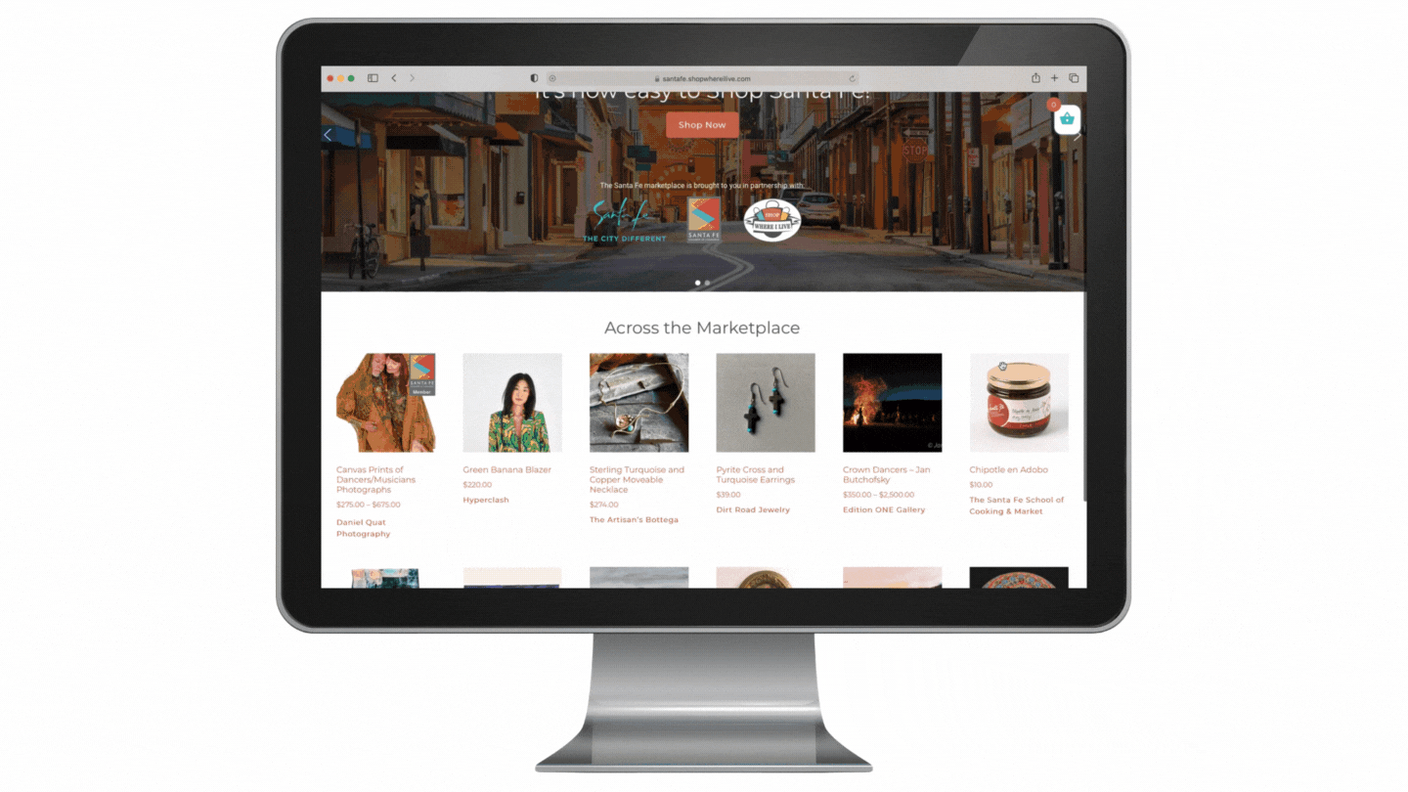
A MARTINEZ MARKETPLACE ALLOWS
FOCUSED MARKETING EFFORTS
Funnel your shop local campaigns and marketing efforts to ONE site, benefiting ALL small businesses on the platform for a higher return on investment.
KEEP DOLLARS LOCAL
Make it easy for residents to shop local from anywhere while introducing small businesses to more customers.
WE MANAGE IT, YOU BENEFIT
Our team at marketplace manages the marketplace on your behalf, directly supporting businesses and customers in your community.

Slide 39
SOCIAL MEDIA MARKETING & CONSULTING Platform Features: Social Assessment – Easily assess local businesses social media strategy Content Design – Assistance with creative content design Engaging Content – Provide all the rich and engaging content for businesses Advanced Scheduling – Schedule and post on advance with an easy-to-use calendar Tailored Strategy – Provide each business with a tailored strategy for managing social media Reputation Monitoring – Monitor local businesses online reputation on review sites like Yelp and provide automatic real-time alerts to businesses Social Optimization – Assist in design and optimization of social media profiles Sweepstakes – Build sweepstakes and giveaways for local businesses Social Deals – Help businesses generate new and returning customers with social deals Social Analytics – Share valuable analytics reports across all social channels

Slide 41
PUBLICITY, PARTNERSHIPS & PROMOTION

Slide 42
NEW PROJECTS

Slide 43
Community/Relocation Guide Featuring :Restaurants, Shopping & Entertainment

Slide 44
Prix Fix
To Go Options
Restaurant List: Hours, Number for Take-Out/Pick-Up Orders

Slide 45
Welcome Packets & Offers – Keeping it Local

Slide 46
2022 FUNDING
Covered basic operational expenses & staff during post pandemic recovery
Allowed us to partially cover up-front expenses to continue to host the events

Slide 47
ADDITIONAL FUNDING BUDGET
STAFFING
Membership Director – Increase hours to F/T – Additional Increase of $20,800 (Add retention to job description)
Hire Administrative/Event support F/T $35,360
Technology Upgrade $5,000
Health Benefits –
TOTAL: $61,160 +
NEW INITIATIVES
Best of Martinez - $700-6000 (Based on active monthly users)
Martinez Marketplace $10,000 for 100 Users or $25,000 for up to 250 businesses
Social Media & Marketing $75,000 – Staff & Oversight Including Photography & Video (limited to a number of pre-qualified business participants)
Suggested additional budget to market & drive traffic through targeted media to the City of Martinez as a dining, shopping and entertainment destination $75,000 ex. Google, Facebook ads, Visit CA, Diablo Magazine, Influencers etc.
TOTAL: $160,700-$181,000

Slide 48
PERFORMANCE The Martinez Chamber & Visit Martinez is Governed by a Board of Directors Staff is responsible for reporting budgets and financials to the board on a monthly & annual basis For all proposed new programs, projects or initiatives the Chamber would provide additional recap reports, analytics and results

Slide 49
CONCLUSION
The Chamber of Commerce and Visit Martinez strives to be a leader, mentor and advocate for the business community
We see ourselves as the marketing arm and partner of the City to market Martinez as a destination
We continue to listen and advocate for members and the business community at large
We co-promote the city and events hosted by Downtown Martinez & Co.
We want to continue to support business growth and retention by expanding our offerings resources, support and services needed
We want to lead the marketing efforts to attract new businesses
We want to offer more opportunities to generate patrons and promote shopping local both on-line and off and create commerce

